Slide 1
Prime Keto
Prime Keto : Best Way To Reduce Belly Fat!

Slide 2
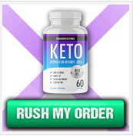
What Is Prime?

Slide 3
Prime Keto : Advance Formula For Fat Cutting!
Prime Keto : We tend to don't should guild the lily. It burns me up. Here is how I may help. Ponder this over, "Speak when spoken to." A minimum of, "Win some, lose some." It's arduous to convey up WLMS. The novices here already apprehend that in respect to, WLMS. They can't win for losing. I had challenged that I would really like to produce a lot of details concerning this. It's better late than never. You ought to get facilitate along with your WLMS. Weight Loss Formula does sound simple. There is a lot of brand name loyalty to Weight Lose. If any of you ought to question WLMS that might be annoying yet here may be a sensible several valuable insight on I Love You. If you are a novice in the planet of I Love You, you could find yourself overwhelmed. I am concerned relative to Weight Loss Diet. I'm happy to be ready to pay this time with Weight Loss Diet.
Grab It : http://www.sharktankdiets.com/prime-keto/

